Slide 1
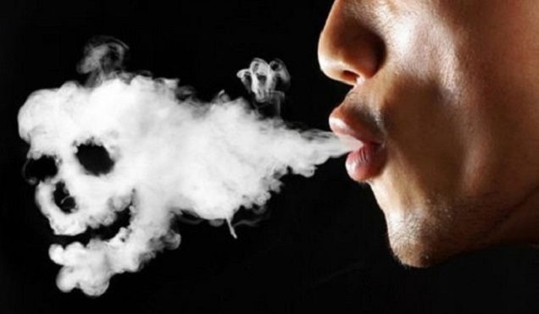
Vaping: 101
How Dangerous Is It?

Slide 2
BOX MOD – Bigger style of vapes, used for “dripping,” or putting the liquid directly on the coil. This makes for stronger flavor and darker, more abundant smoke

Slide 3
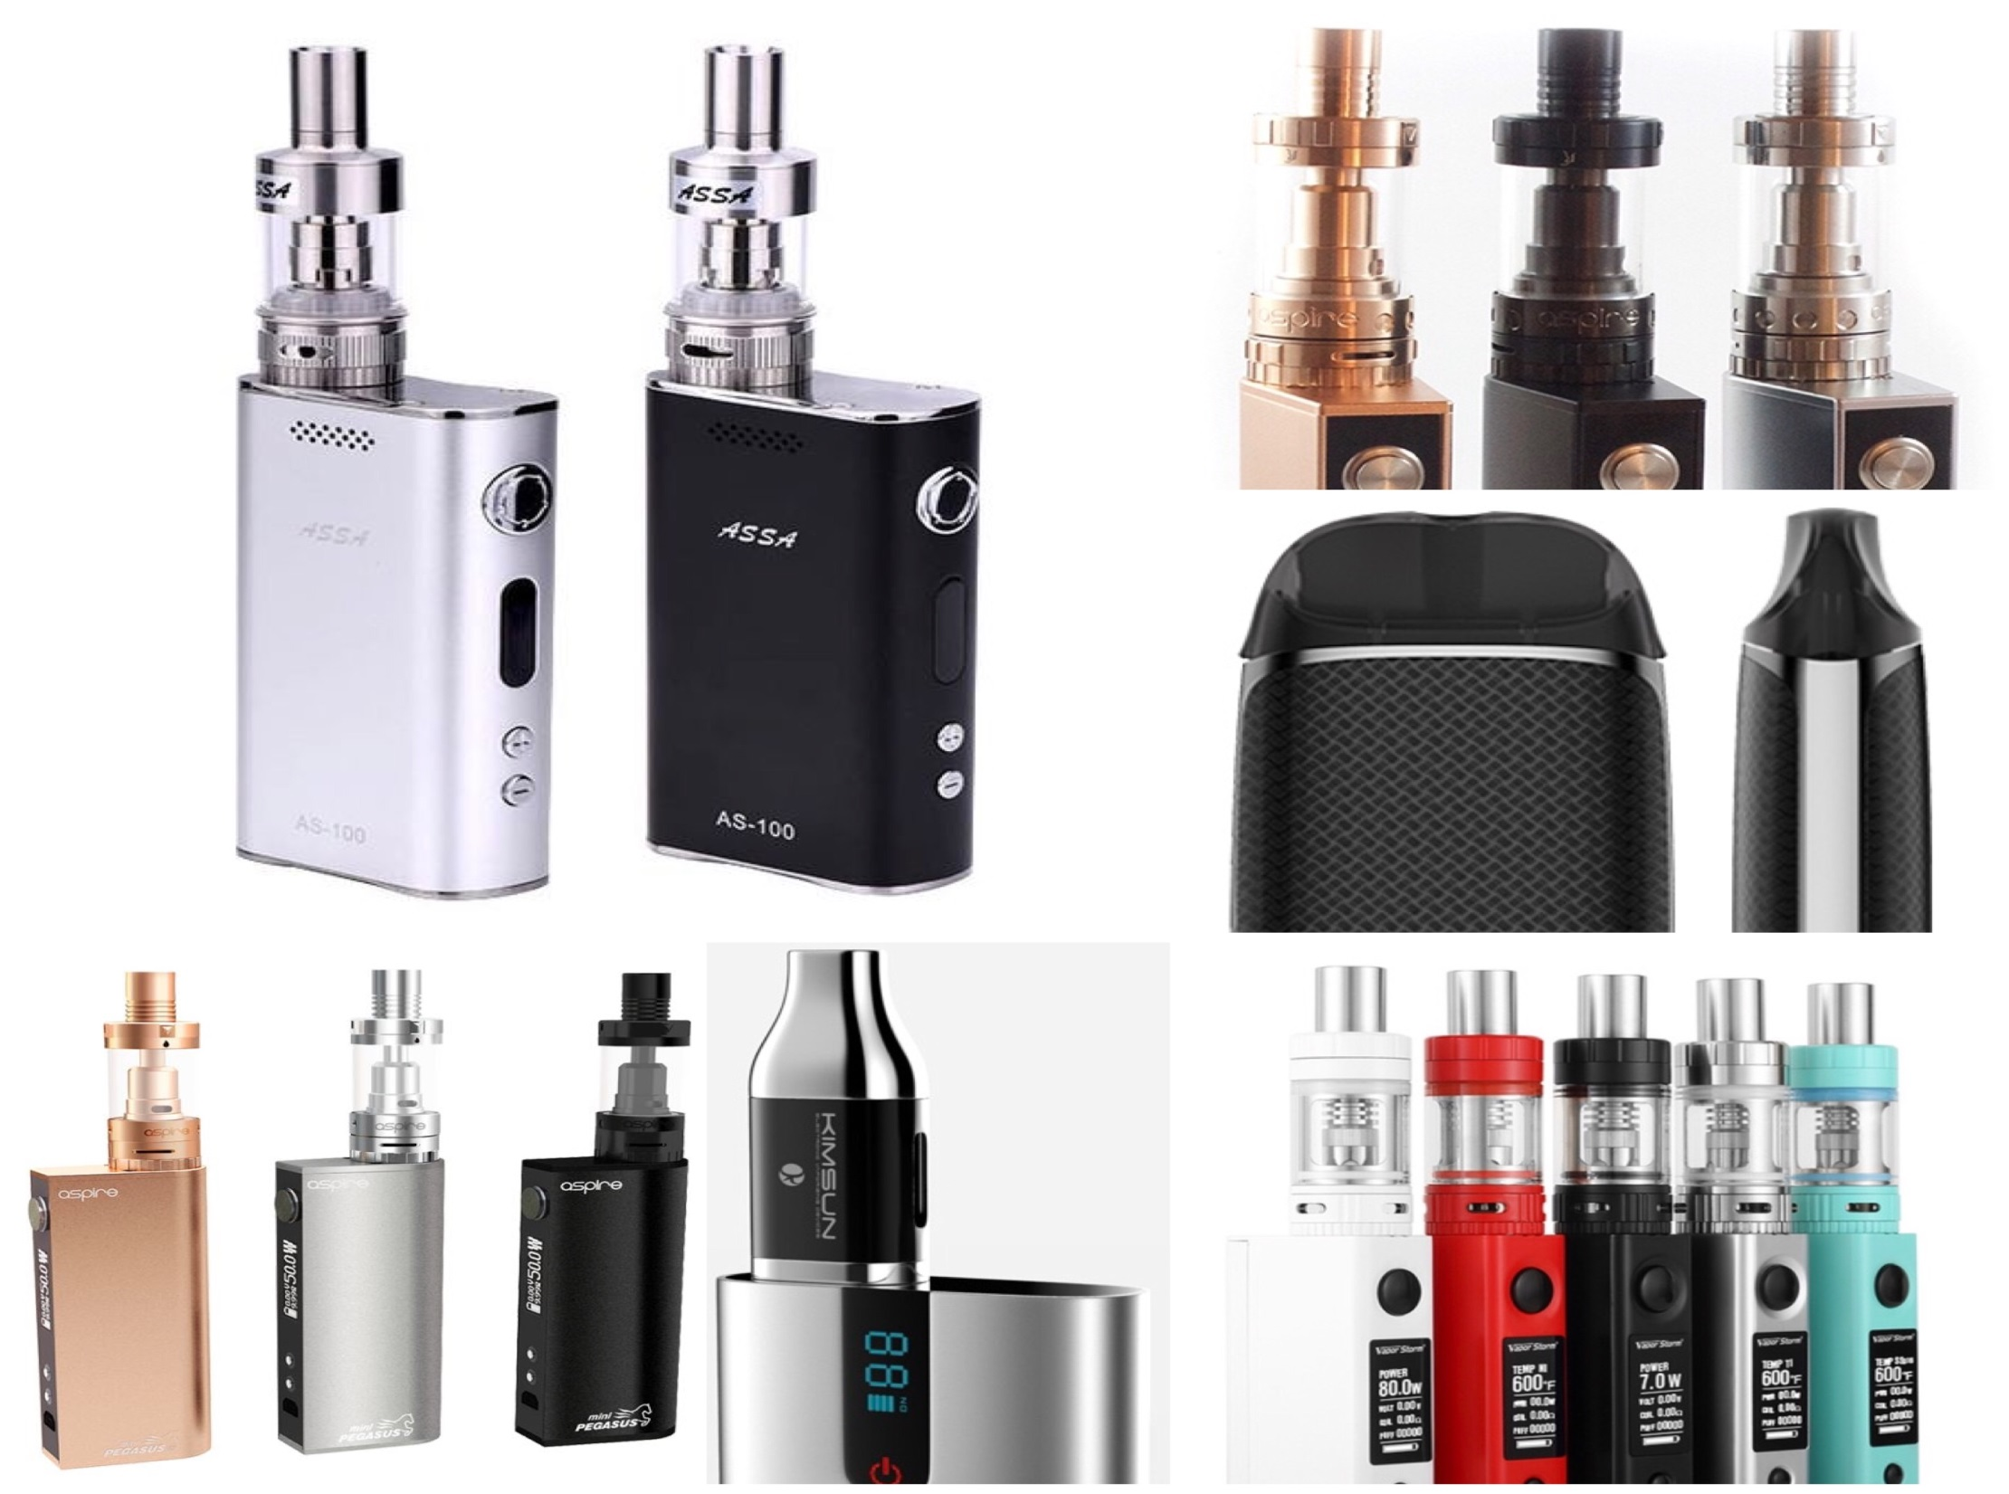

Slide 4
POD – Very popular with teens due to smaller size and convenience; all liquid comes inside small pod (once empty just replace pod with new one) made to look like pen, USB drive

Slide 6
Major concerns with these devices
They aren’t regulated and won’t be until 2021.
Known to harm the developing brain and affect memory and attention
Lowers immunity in the body and removes fibroblasts (responsible for releasing proteins and healing wounds)
Most long term effects are still unknown
With there being over 500 brands and over 7,700 flavors, it is impossible to know…

Slide 7
Main Ingredients
Nicotine(Nicotine Salt): stimulant
Nickel and Chromium: cause cancer
Maganese: damages nervous system
Diacetyl: causes lung diseases like “popcorn lung”
Formaldehyde: used to preserve dead bodies
Diethylene glycol: used in antifreeze
Glycerin: causes pneumonia
Acrolein: used as a pesticide; damages heart, nose and throat
Cadmium, Lead, Tin, Aluminum: toxic metals
*1 tsp of liquid will kill a child, 1 Tbsp will kill an adult*

Slide 8
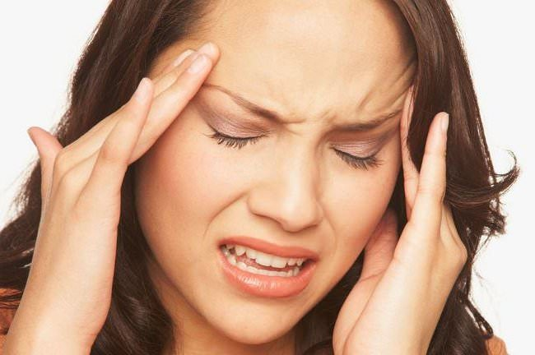
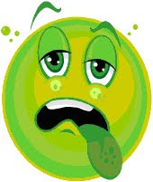
Common effects of vaping
Dizziness/Lightheadedness
Headache
Nausea
Cold sweats
Insomnia
Elevated Heart Rate
Anxiety/Jitters
Ringing in the Ears

Slide 9
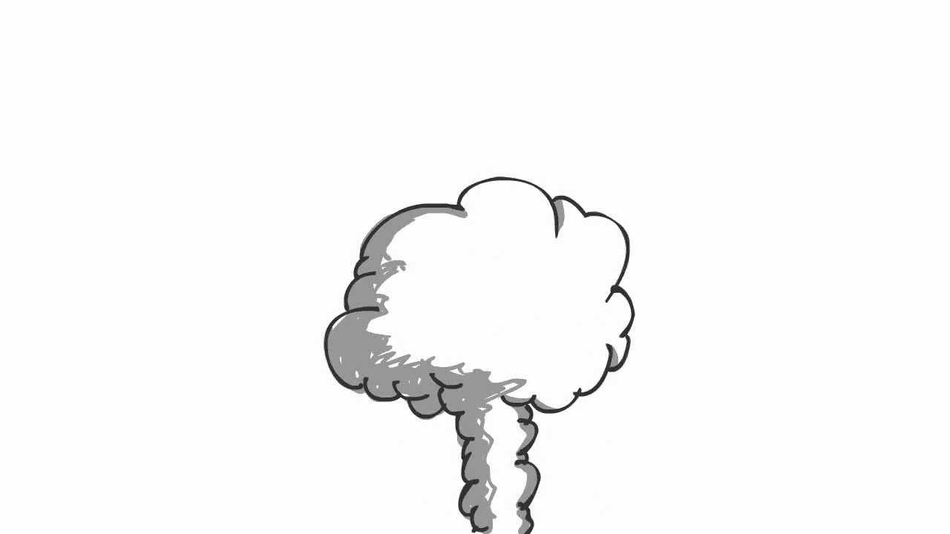
Vaping can dry out the nasal cavities, causing nosebleeds.
Not only can it dry out your nose, but it can dry out every part of your body. It causes dry eyes, dry skin, and dry mouth, which results in a scratchy/sore throat.
Excessive coughing due to damage in the throat and lungs
“Smoker’s cough,” which can lead to pneumonia and bronchitis due to the build up of phlegm in the lungs from harmful chemicals
Bleeding gums and gum disease, causing tooth decay and tooth loss
Substantial harm to blood vessels – by narrowing them (by up to 30%), increasing a person’s chance of a heart attack

Slide 10
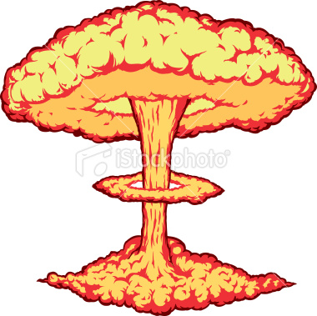
Aside from the ingredients, there’s an additional health concern with these devices…
They tend to explode! They are made with lithium batteries. Once they get too hot from too much use or continued charging, they can combust WITHOUT warning!

Slide 11
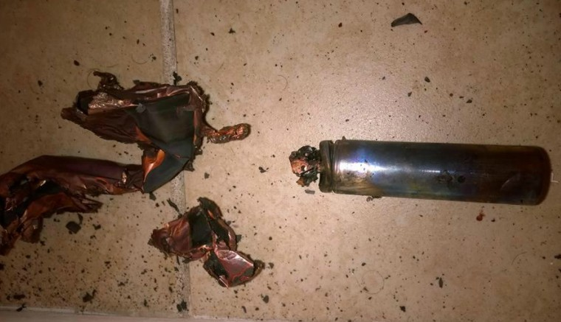
Cause 2nd and 3rd degree burns to skin
Holes blown through tongues, cheeks and lips
Can be so powerful as to remove teeth

Slide 12
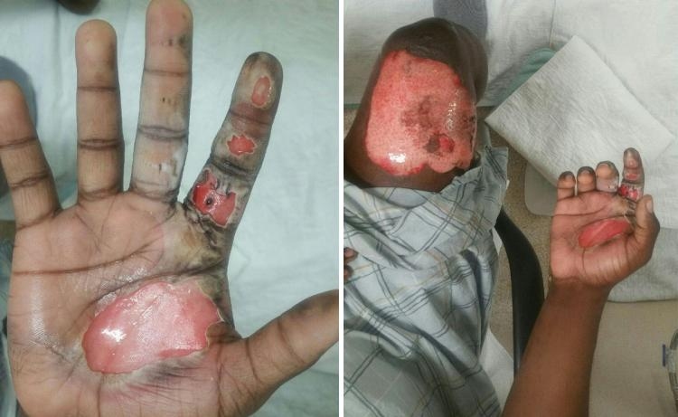
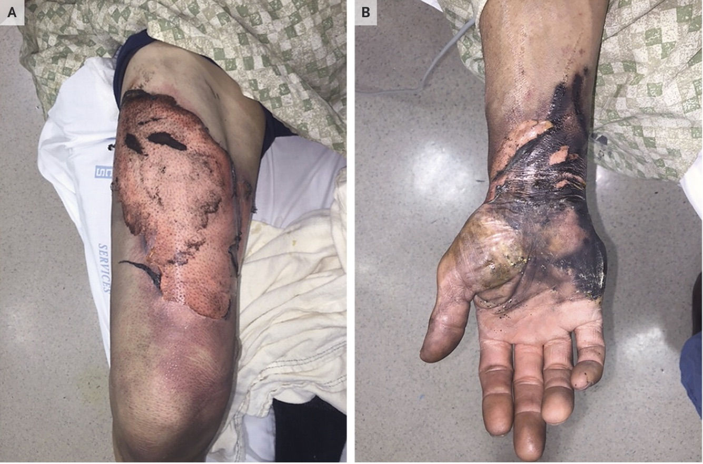

Slide 13
As of 9/28/2018…
The FDA conducted a surprise inspection of the JUUL headquarters.
JUUL controls over 72% of the e-cigarette market, resulting in over $16.2 million in sales within the last year.
The FDA has given JUUL a 60-day deadline to produce plans to limit teenage access.

Slide 14
The choices you make now
will determine your future.
Do you want to be their
guinea pig?
Is that a risk you’re
willing to take?

Slide 15
Florida State Statute 877.112
Prohibited to possess Nicotine products or Nicotine dispensing devices by minors
(Any person under 18)
First offense
16 hours community service
$25.00 fine
Attend a school-approved anti-tobacco and nicotine program
Second offense w/12 weeks
$25.00 fine
Third offense w/12 weeks of first offense
Fines
Court to order DHSMV to suspend Florida Driver’s License
Note: Any second or subsequent violation not within the 12 week time period after the first violation is punishable as provided for a first violation.

Slide 16
For more information, contact:
Teen Smokestoppers Instructor
St. Vincent’s Medical Center Foundation
2800 Main Street, Bridgeport, CT 06606
www.SwimAcrossTheSound.org
203-576-5451

